Slide 1
Progress Update
Hurricane Wind Speed Prediction Using Deep Learning and Machine Learning

Slide 2
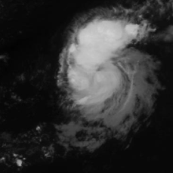
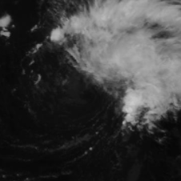
Project Aim
We aim to design and develop a system using Deep Learning and Machine Learning which accurately predicts the hurricane’s speed using satellite images.
The dataset consists of 114,634 366x366 single-band images; 70,257 images in the train set and 44,377 in the test set.

Slide 3
Milestones
October 19: Completing of preparation of images for baseline model and implementation and initial results of baseline model.
November 2: Hyperparameter Tuning results for baseline model. Completion of preparation of images for pre-trained models (converting single-band images to RGB images based on timestep).
November 16: Completion of pre-trained model training, hyperparameter tuning.
November 30: Feature Extraction using CNNs and Implementation of Machine Learning Models
December 14: Model evaluation and Performance Comparison. Completion of Final Report.

Slide 4
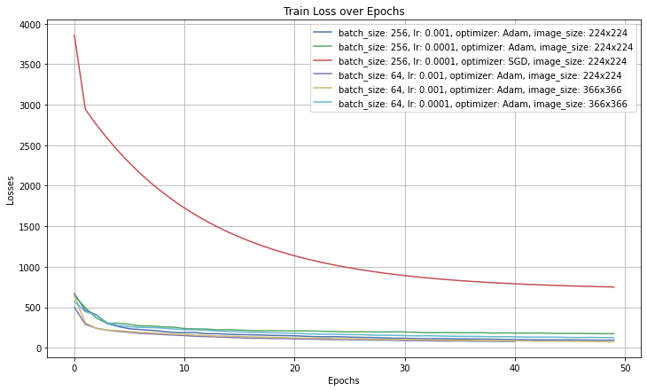
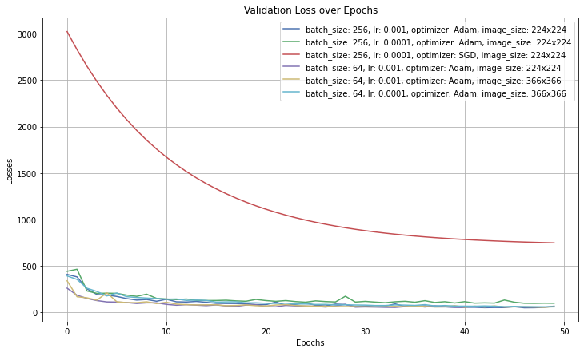
Hyperparameter Tuning Results

Slide 5
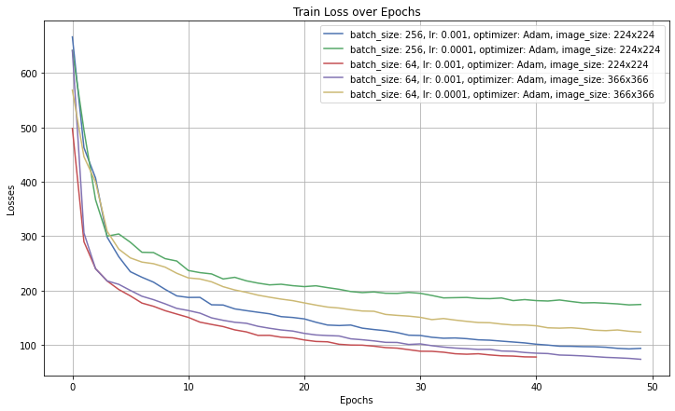
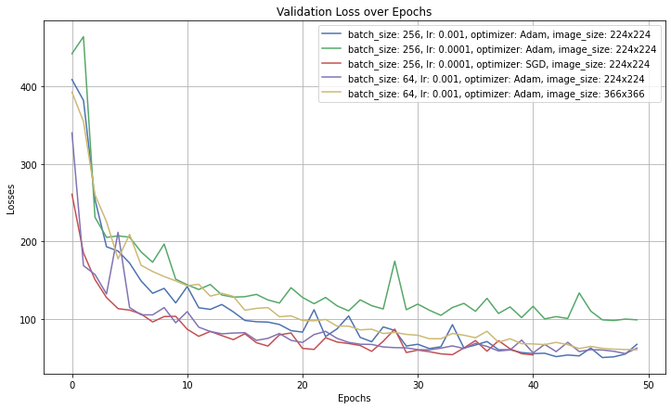
Hyperparameter Tuning Results

Slide 6
Performance on the Test Set

Slide 7
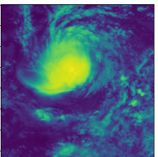
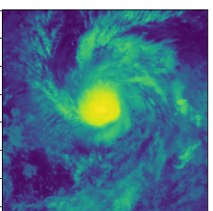
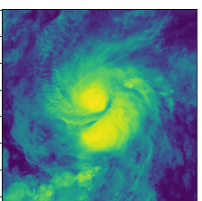
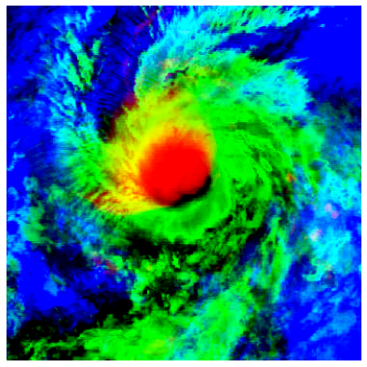
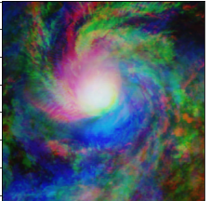
Preparation of images for pre-trained models
t-2i
t-i
t
RGB coloured
No colour

Slide 8
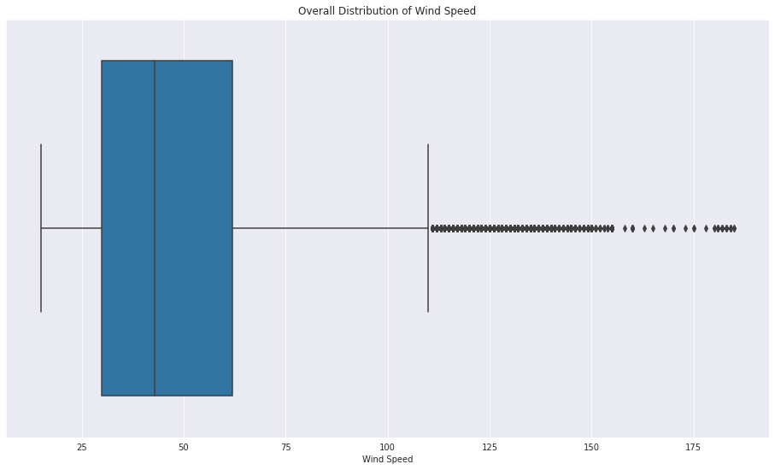
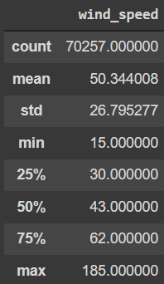
Help
Which combination of images we should use for training pre-trained models?
How should we address outliers, and reduce class imbalance?

Slide 9
Thank You

